Slide 1
Image Processing and Analysis
Ivica Dimitrovski

Slide 2
Introduction
Image processing refers to the manipulation and analysis of images to prepare them for further use, enhance visual quality or extract meaningful information
When working with images, two related concepts frequently arise
Image processing
Image analysis
Image processing transforms images by applying mathematical operations to the pixel values
Often these operations are very simple (e.g. averaging neighboring pixels)
Image analysis is oriented towards extracting some knowledge from the image
This knowledge isn’t represented in terms of pixels, but rather as structured data, such as numerical vectors, tables, or other analytical formats

Slide 3
Core Techniques in Image Processing and Analysis
Image Acquisition
Cameras, scanners, and sensors are used to collect/capture visual data into digital images
Preprocessing
Enhance the quality of the data and prepare it for further analysis
Segmentation
Divide the image into distinct regions or objects
Feature Extraction
Simplify the data while maintaining important information about the image, for example textures, shapes, and colors
Classification and Recognition
The processed image or objects within it are classified using machine learning algorithms

Slide 4
Image Processing and Related Fields

Slide 5
Applications of Digital Image Processing (1)
Medical Imaging
MRI and CT Scans: Enhancing the clarity of MRI and CT scans for better diagnosis and treatment planning
X-Ray Imaging: Improving the quality and detail of X-ray images to detect fractures, tumors, and other anomalies
Ultrasound Imaging: Enhancing ultrasound images for more accurate visualization of internal organs and fetal development
Remote Sensing
Satellite Imaging: Analyzing satellite images for applications like land use mapping and resource monitoring
Aerial Photography: Using drones and aircraft to capture high-resolution images for mapping and surveying
Environmental Monitoring: Monitoring environmental changes and natural disasters using image analysis

Slide 6
Applications of Digital Image Processing (2)
Industrial Inspection
Quality Control: Automating the inspection process to ensure product quality and consistency
Defect Detection: Detecting defects in manufacturing processes to maintain high standards
Robotics Vision: Enabling robots to interpret and navigate their environment using image processing techniques
Security and Surveillance
Facial Recognition: Identifying individuals by analyzing facial features for security purposes
Object Detection: Detecting and identifying objects in surveillance footage to enhance security measures
Motion Detection: Monitoring and detecting movement in video feeds for security and surveillance
Automotive Industry
Autonomous Vehicles: Processing images from sensors to enable autonomous driving
Traffic Sign Recognition: Identifying and interpreting traffic signs to assist drivers and autonomous systems
Driver Assistance Systems: Enhancing driver safety with features like lane departure warnings and collision avoidance

Slide 7
Applications of Digital Image Processing (3)
Entertainment and Multimedia
Photo and Video Editing: Enhancing and manipulating images and videos for artistic and practical purposes
Virtual Reality and Augmented Reality: Creating immersive experiences by integrating real-world images with virtual elements
Gaming: Enhancing graphics and creating realistic environments in video games
Document Processing
OCR (Optical Character Recognition): Converting printed text into digital text for easy editing and searching
Barcode and QR Code Scanning: Reading and interpreting barcodes and QR codes for quick information retrieval
Document Enhancement and Restoration: Improving the quality of scanned documents and restoring old or damaged documents

Slide 8
What is an image?
Image is a visual representation in form of a function f(x,y) where f is related to the brightness (or color) at point (x,y)
x and y represent the spatial coordinates (position) in the image
Most images are defined over a rectangular domain, meaning they exist within a fixed width and height
Continuous in amplitude and space
In the real world, brightness or color values are continuous, meaning they can take any value within a certain range
The function f(x,y) is defined over a continuous space, meaning an image is theoretically an infinite collection of points

Slide 9
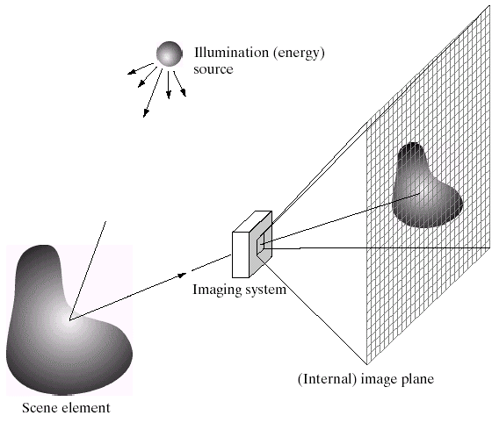
Imaging
The mapping of a 3D world object into a 2D digital image plane is called imaging
Each point on the 3D object must correspond to the image plane
Light reflects from every object that we see thus enabling us to capture all those light-reflecting points in our image plane
The lenses and mirrors are crucial in focusing the light coming from the 3D scene to produce the image on the image plane
The goals of image sensors like the CCD or the CMOS sensors are to simply transform the optical image into an electronic signal

Slide 10
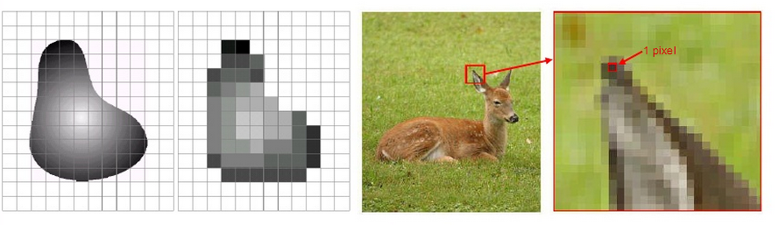
What is a Digital Image?
Digital images approximate this continuous function f(x,y) by using sampling in space and quantized intensity values (discretizing amplitude)
Remember digitization implies that a digital image approximates a real scene
Instead of an infinite function, we get a grid of values, called picture elements or pixels, where each pixel represents a sample of the continuous image function
Quantization is the number of grey levels in the digital image. The transition of the continuous values from the image function to its digital equivalent is called quantization

Slide 11
Technical Aspects of Digital Images
Pixels
Resolution
Color Depth
Image Formats

Slide 12
Pixel
Short for "picture element," is the smallest unit of a digital image
Each pixel contains numerical values that represent its color and intensity. All these pixels form a digital image
In a grayscale image, each pixel has a single value representing the intensity of light
In a color image, each pixel typically has three values representing the intensity of the primary colors (red, green, and blue) in the RGB color model

Slide 13
Resolution
Resolution refers to the amount of detail an image holds, it occurs technically as the number of pixels in the image, often measured in pixels per inch (PPI) or dots per inch (DPI)
We use pixels to measure the size of an image by width and height
Higher resolution means more pixels are used to represent the image, resulting in greater detail and clarity
Common resolutions for digital images include 720p, 1080p, and 4K
Today's standard Full HD image would measure 1920x1080 pixels or around 2.1 megapixels (the total number of pixels is 2.073.600)

Slide 14
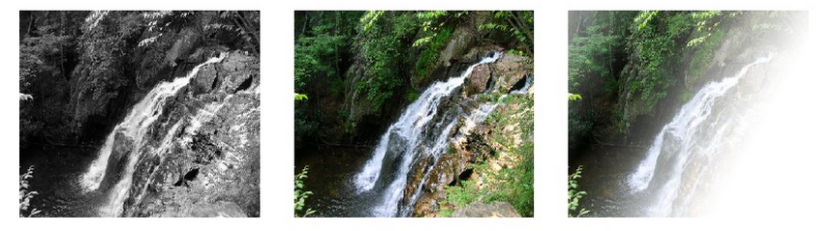
Color Depth
Also known as bit depth, determines the number of colors that can be displayed in an image
It is measured in bits per pixel (bpp)
1 bpp: 2 colors (black and white)
8 bpp: 256 colors
24 bpp: 16.7 million colors (true color)
32 bpp (Red, Green, Blue, and “Alpha”, a.k.a. Opacity)
8-bit (256 levels) provides a good trade-off between quality, human perception, storage, and compatibility
The human eye can distinguish around 200-250 grayscale levels under normal lighting conditions
Lower quantization (e.g., 4-bit, 16 levels) can cause banding artifacts (visible steps in shading)

Slide 15
Image Formats
Digital images can be stored in various formats, each with its own characteristics and uses
JPEG: Common for photographs, offers lossy compression to reduce file size
PNG: Supports lossless compression and transparency, often used for web graphics
GIF: Limited to 256 colors, supports simple animations
BMP: Uncompressed, large file sizes, used in certain applications where quality is paramount
TIFF: Supports multiple layers and lossless compression, commonly used in professional photography and printing

Slide 16

OpenCV: Your Tool for Digital Image Processing
OpenCV (Open Source Computer Vision Library) is a powerful and widely-used open-source library for digital image processing and computer vision
Provides a comprehensive suite of functions and algorithms that enable developers and researchers to manipulate, analyze, and understand visual data
Founded in 1999 by Intel, OpenCV was envisioned as a way to boost the accessibility of computer vision tools
Intel recognized that by making such tools available and open-source, a greater number of applications and innovations would emerge
Gary Bradski, one of the key figures behind OpenCV, played a crucial role in its early development.
The first OpenCV version was 1.0.
When OpenCV was designed the focus was real-time applications for computational efficiency. All things are written in optimized C/C++ to take advantage of multi-core processing
OpenCV is released under Apache License Version 2.0 and hence it’s free for both academic and commercial use
It has C++, C, Python and Java interfaces and supports Windows, Linux, Mac OS, iOS and Android
The current OpenCV version is 4.11.0

Slide 17
Key Features of OpenCV
Comprehensive Libraries: OpenCV includes a wide range of libraries for various image processing tasks, including filtering, geometric transformations, color space conversions, and feature detection
Real-Time Capabilities: Designed for real-time applications, OpenCV can process video and image streams efficiently. It is used in areas where real-time performance is crucial, such as robotics and autonomous vehicles.
Cross-Platform Support: OpenCV is compatible with multiple operating systems, including Windows, macOS, and Linux. It also supports various hardware architectures, including mobile devices
Integration with Other Libraries: OpenCV can be integrated with other libraries and frameworks, such as TensorFlow, PyTorch, and SciPy, to build advanced machine learning and artificial intelligence applications
Extensive Documentation and Community Support: The library comes with extensive documentation, tutorials, and an active community, making it easier for users to get help and learn how to use OpenCV effectively

Slide 18
Setting Up OpenCV and NumPy
To start using OpenCV, you need to install the library
Before installing OpenCV, ensure you have Python installed on your system, which is one of the most popular languages for working with OpenCV
Installing OpenCV via pip
Open a terminal or command prompt and run the following command to install OpenCV:
pip install opencv-python
NumPy is a scientific computation package
It offers many functions and utilities to work with N-Dimension arrays
Largely used by other libraries such as OpenCV, TensorFlow and PyTorch to deal with multi dimensional arrays (e.g., tensors or images)
We can easily install NumPy using pip by running
pip install numpy

Slide 19
Introduction to Point Operators
Point operators apply a transformation function to each pixel independently
They modify pixel intensity values without considering neighboring pixels
Used for contrast enhancement, thresholding, and gamma correction
y
L
x
L
L=255: for grayscale images

Slide 20
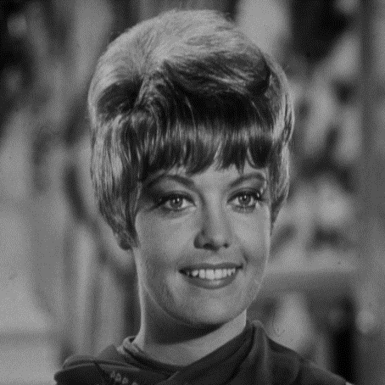
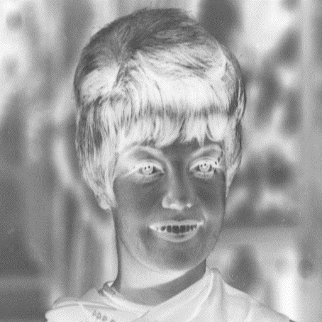
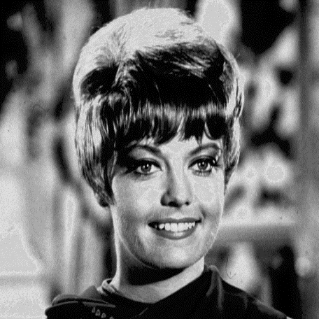
Types of Point Operators (1)
Digital negative
Contrast stretching
L
y_{b}
y_{a}
0
L
x
a
b
x
0
L

Slide 21
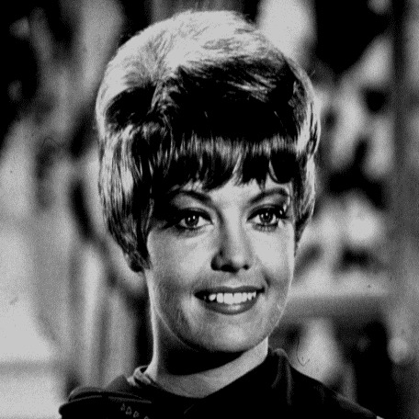
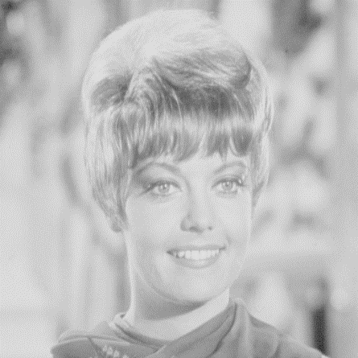
Types of Point Operators (2)
Clipping
Range compression
0
a
b
L
x
x
0
L
c=100

Slide 22
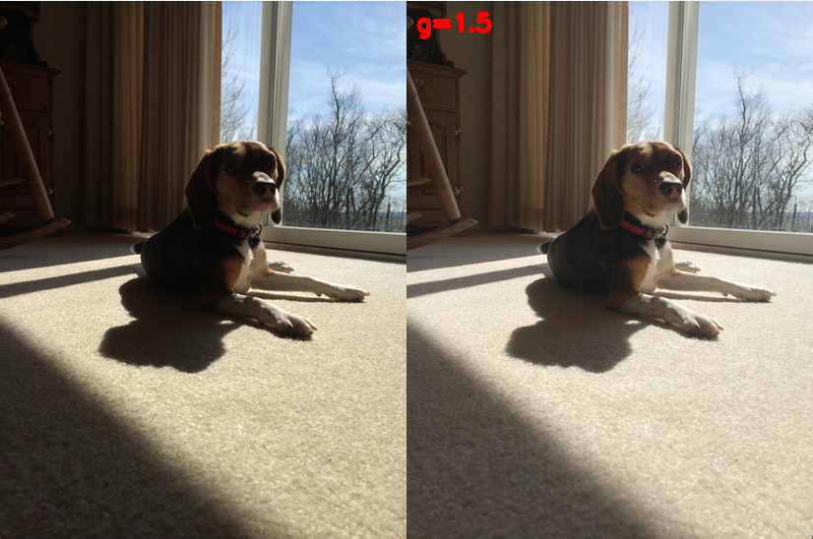
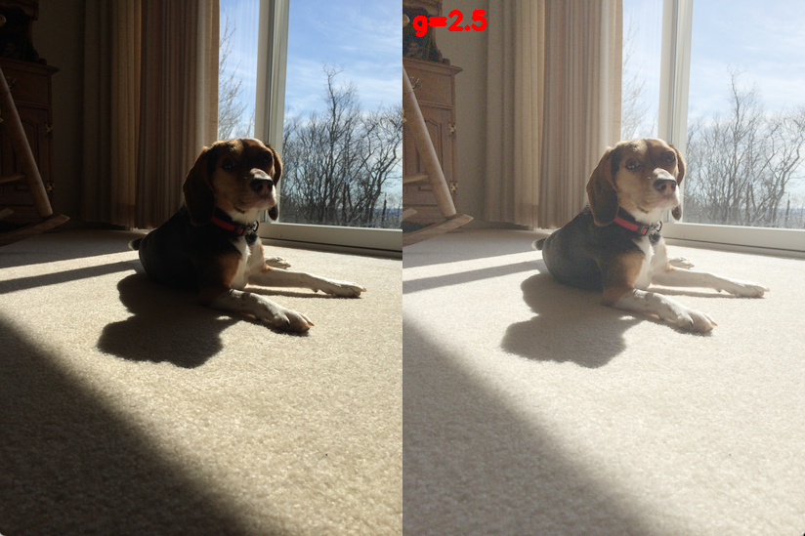
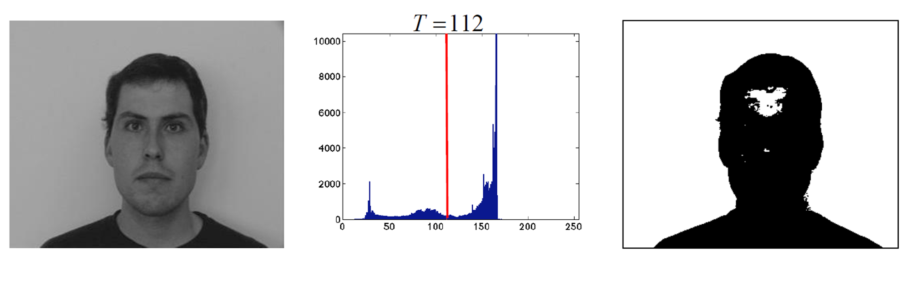
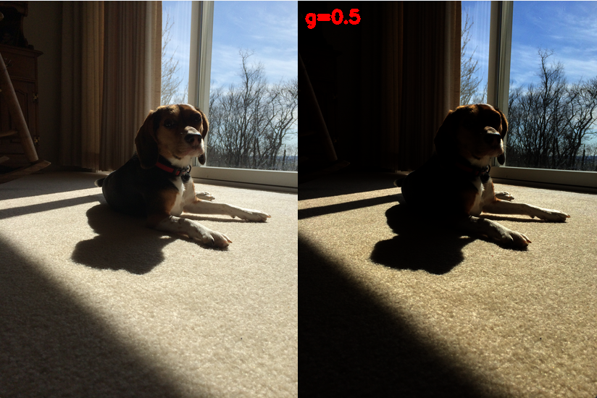
Types of Point Operators (3)
Thresholding
Converts a grayscale image into a binary image
Any pixel above a set threshold is converted to white; others to black
Used for segmentation and object detection
Gamma correction
Adjusts brightness non-linearly based on human perception (greater sensitivity to relative differences between darker tones than between lighter ones)
Formula: new_image = original_image ^ (1 / g)
Useful for correcting lighting conditions in images

Slide 23
Introduction to Histograms
A histogram represents the distribution of pixel intensity values in an image
X-axis: Pixel intensity values (0-255 for 8-bit images)
Y-axis: Frequency of pixels at each intensity level
Useful for analyzing brightness, contrast, and exposure

Slide 24
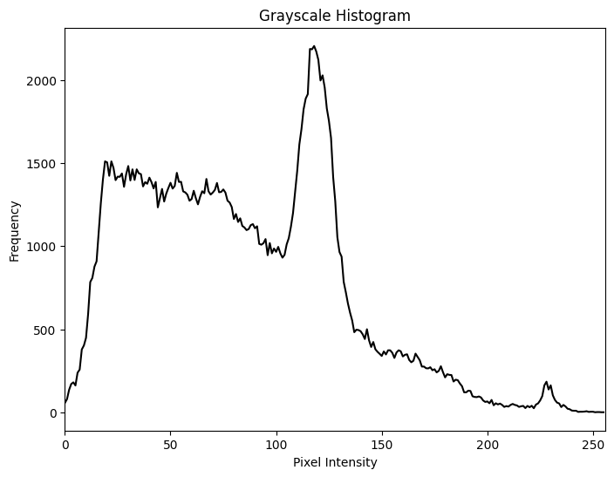
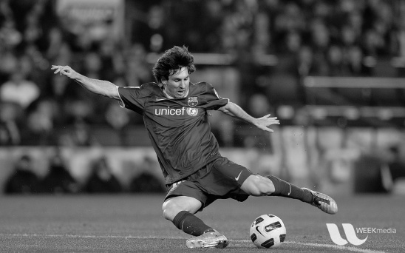
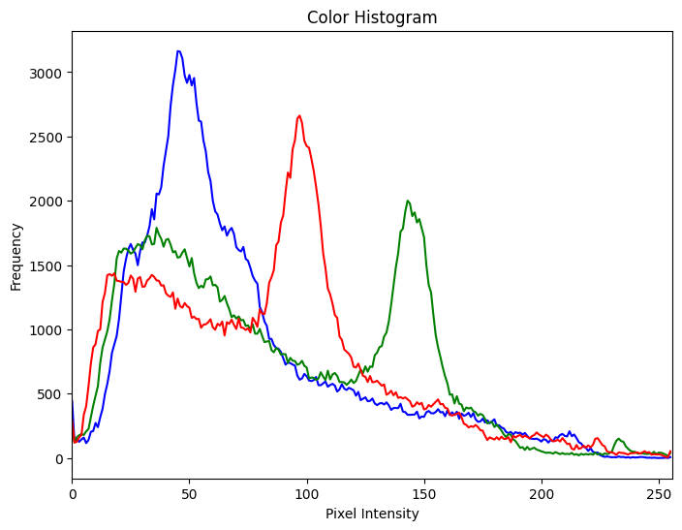
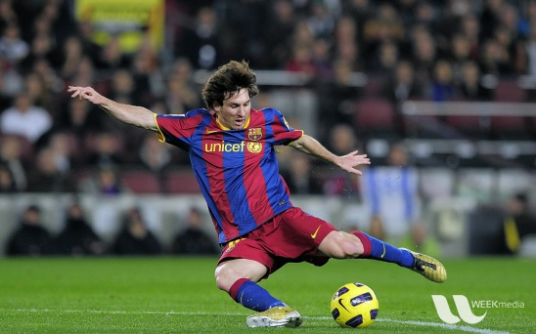
Types of Histograms
Grayscale Histogram - Represents intensity distribution in a grayscale image
Color Histogram - Separate histograms for Red, Green, and Blue channels in a color image

Slide 25
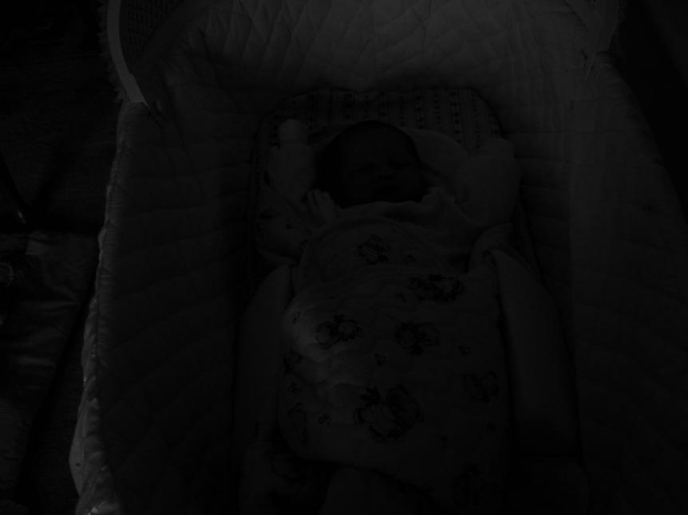
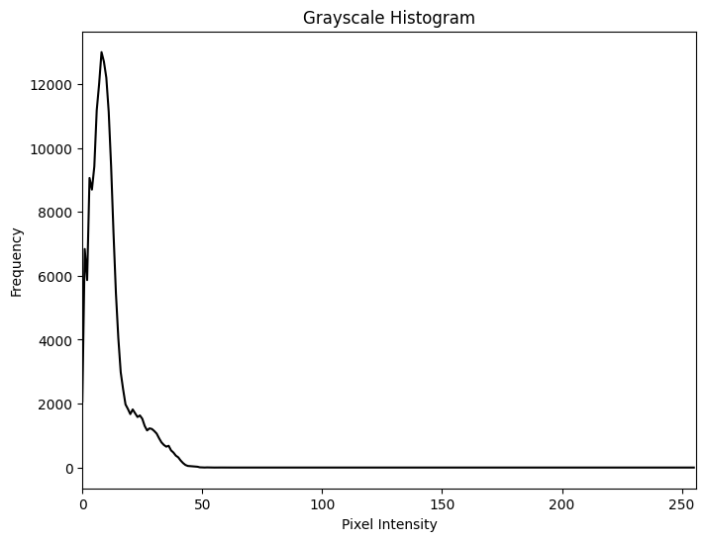
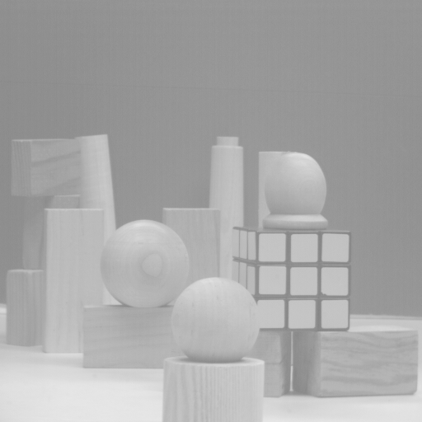
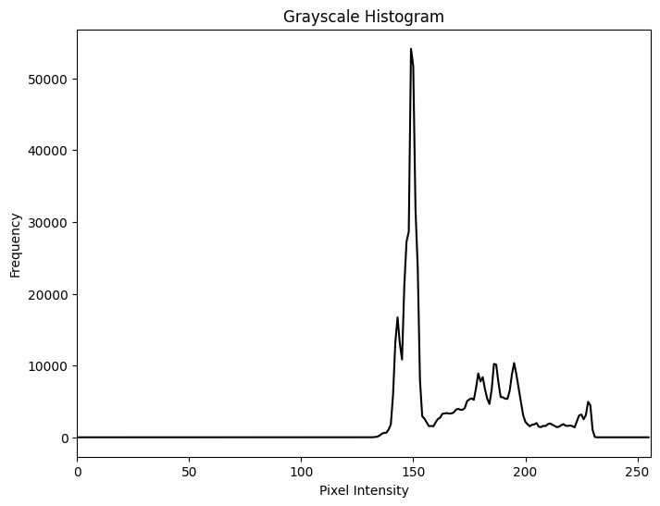
Interpreting Histograms (1)
A left-skewed histogram indicates a dark image (low brightness)
A right-skewed histogram indicates a bright image (high brightness)

Slide 26

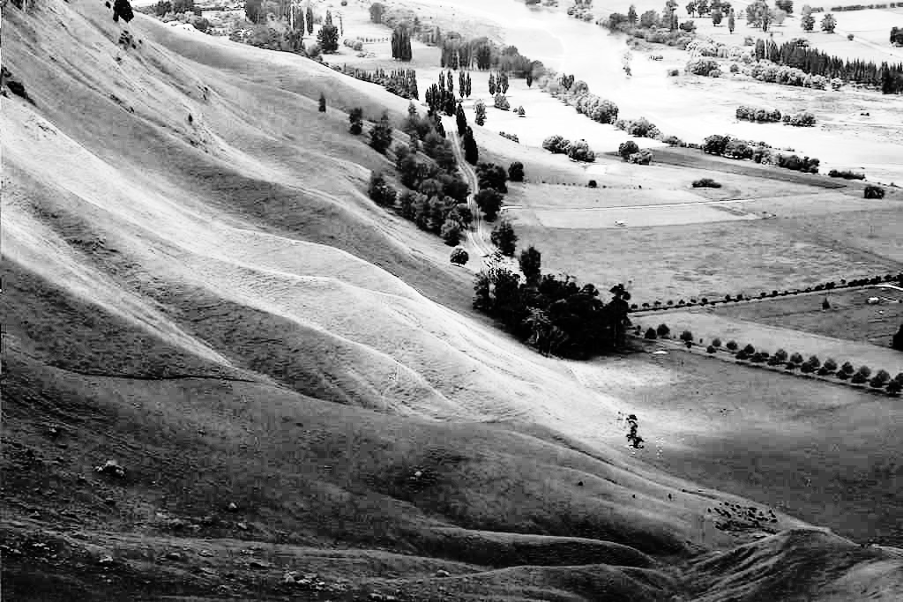
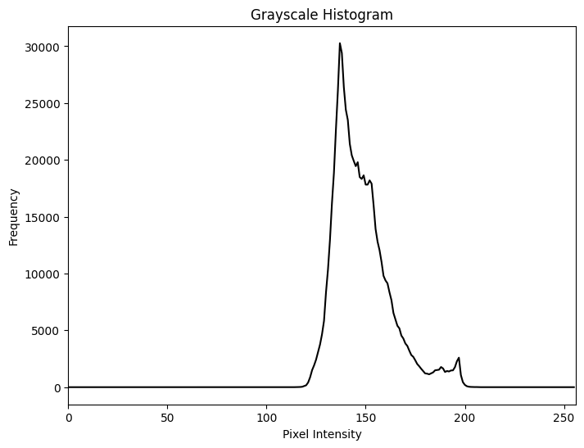
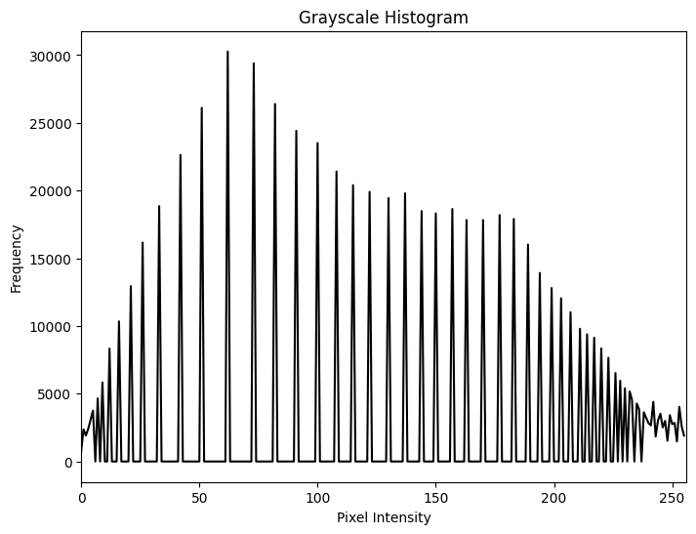
Interpreting Histograms (2)
A compressed histogram indicates low contrast
A stretched histogram indicates high contrast

Slide 27
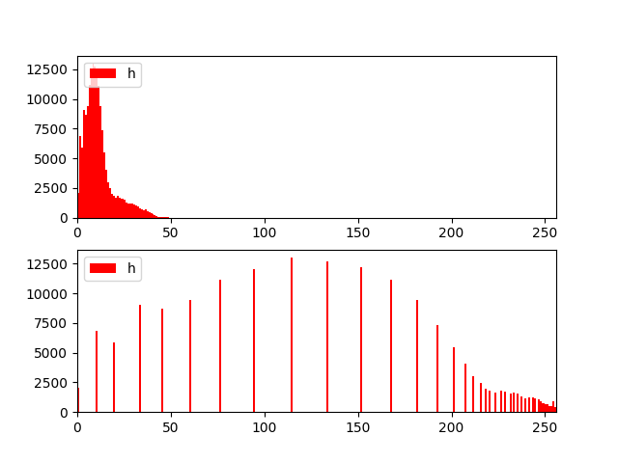

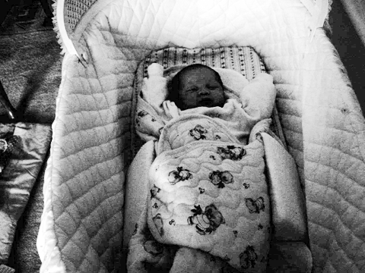
Histogram Equalization
Enhances contrast by redistributing pixel intensities
Spreads out intensity values to improve detail visibility
Works well for images with poor contrast
How histogram equalization works
Compute the histogram of the image
Compute the cumulative distribution function (CDF)
Normalize the CDF to map intensity values
Apply the transformation to obtain an enhanced image
Histogram equalized image has better brightness distribution
Useful for enhancing medical, satellite, and low-light images

Slide 28
Pixels and Image Filtering
Capabilities of point operations are limited
Filters: combine pixel’s value + values of neighbors
Combining multiple pixels needed for certain operations
Blurring, Smoothing
Sharpening
There are two broad categories of image filtering techniques
Spatial domain techniques
Direct manipulation of image pixels (intensity values)
Smoothing, sharpening, measuring texture
Frequency domain techniques
Manipulation of Fourier transform or wavelet transform of an image
Denoising, sampling, image compression

Slide 29
What point operations can’t do
Example: sharpening

Slide 30
What point operations can’t do
Other cool artistic patterns by combining pixels

Slide 31


Example: box filter
An image operation that combines each pixel’s intensity I[x, y] with that of neighboring pixels
Average/weighted of group of pixels
H$[⋅ ,⋅ ]$
1
1
1
1
1
1
1
1
1
Slide credit: David Lowe (UBC)

Slide 32
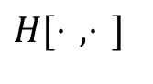
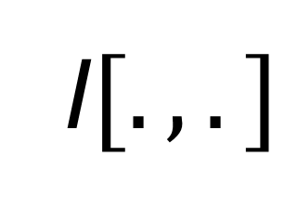

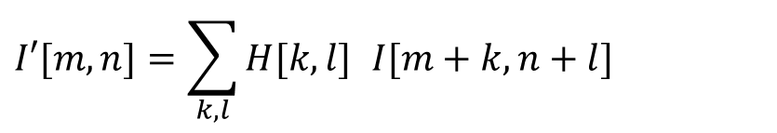
Image filtering
1
1
1
$$H[⋅ ,⋅ ]$$
1
1
1
1
1
1
I$[.,.]$
$$I′[.,.]$$
0 | 0 | 0 | 0 | 0 | 0 | 0 | 0 | 0 | 0
0 | 0 | 0 | 0 | 0 | 0 | 0 | 0 | 0 | 0
0 | 0 | 0 | 90 | 90 | 90 | 90 | 90 | 0 | 0
0 | 0 | 0 | 90 | 90 | 90 | 90 | 90 | 0 | 0
0 | 0 | 0 | 90 | 90 | 90 | 90 | 90 | 0 | 0
0 | 0 | 0 | 90 | 0 | 90 | 90 | 90 | 0 | 0
0 | 0 | 0 | 90 | 90 | 90 | 90 | 90 | 0 | 0
0 | 0 | 0 | 0 | 0 | 0 | 0 | 0 | 0 | 0
0 | 0 | 90 | 0 | 0 | 0 | 0 | 0 | 0 | 0
0 | 0 | 0 | 0 | 0 | 0 | 0 | 0 | 0 | 0
 | 0
0 | 0 | 0 | 0 | 0 | 0 | 0 | 0 | 0 | 0
0 | 0 | 0 | 0 | 0 | 0 | 0 | 0 | 0 | 0
0 | 0 | 0 | 90 | 90 | 90 | 90 | 90 | 0 | 0
0 | 0 | 0 | 90 | 90 | 90 | 90 | 90 | 0 | 0
0 | 0 | 0 | 90 | 90 | 90 | 90 | 90 | 0 | 0
0 | 0 | 0 | 90 | 0 | 90 | 90 | 90 | 0 | 0
0 | 0 | 0 | 90 | 90 | 90 | 90 | 90 | 0 | 0
0 | 0 | 0 | 0 | 0 | 0 | 0 | 0 | 0 | 0
0 | 0 | 90 | 0 | 0 | 0 | 0 | 0 | 0 | 0
0 | 0 | 0 | 0 | 0 | 0 | 0 | 0 | 0 | 0
$$I′[m,n]=\sum_{k,l}{H[k,l]} I[m+k,n+l]$$
Credit: S. Seitz
Notes:
ones, divide by 9

Slide 33
Image filtering
1
1
1
$$H[⋅ ,⋅ ]$$
1
1
1
1
1
1
I$[.,.]$
$$I′[.,.]$$
0 | 0 | 0 | 0 | 0 | 0 | 0 | 0 | 0 | 0
0 | 0 | 0 | 0 | 0 | 0 | 0 | 0 | 0 | 0
0 | 0 | 0 | 90 | 90 | 90 | 90 | 90 | 0 | 0
0 | 0 | 0 | 90 | 90 | 90 | 90 | 90 | 0 | 0
0 | 0 | 0 | 90 | 90 | 90 | 90 | 90 | 0 | 0
0 | 0 | 0 | 90 | 0 | 90 | 90 | 90 | 0 | 0
0 | 0 | 0 | 90 | 90 | 90 | 90 | 90 | 0 | 0
0 | 0 | 0 | 0 | 0 | 0 | 0 | 0 | 0 | 0
0 | 0 | 90 | 0 | 0 | 0 | 0 | 0 | 0 | 0
0 | 0 | 0 | 0 | 0 | 0 | 0 | 0 | 0 | 0
 | 0 | 10
0 | 0 | 0 | 0 | 0 | 0 | 0 | 0 | 0 | 0
0 | 0 | 0 | 0 | 0 | 0 | 0 | 0 | 0 | 0
0 | 0 | 0 | 90 | 90 | 90 | 90 | 90 | 0 | 0
0 | 0 | 0 | 90 | 90 | 90 | 90 | 90 | 0 | 0
0 | 0 | 0 | 90 | 90 | 90 | 90 | 90 | 0 | 0
0 | 0 | 0 | 90 | 0 | 90 | 90 | 90 | 0 | 0
0 | 0 | 0 | 90 | 90 | 90 | 90 | 90 | 0 | 0
0 | 0 | 0 | 0 | 0 | 0 | 0 | 0 | 0 | 0
0 | 0 | 90 | 0 | 0 | 0 | 0 | 0 | 0 | 0
0 | 0 | 0 | 0 | 0 | 0 | 0 | 0 | 0 | 0
$$I′[m,n]=\sum_{k,l}{H[k,l]} I[m+k,n+l]$$
Credit: S. Seitz
Notes:
ones, divide by 9

Slide 34
Image filtering
1
1
1
$$H[⋅ ,⋅ ]$$
1
1
1
1
1
1
I$[.,.]$
$$I′[.,.]$$
0 | 0 | 0 | 0 | 0 | 0 | 0 | 0 | 0 | 0
0 | 0 | 0 | 0 | 0 | 0 | 0 | 0 | 0 | 0
0 | 0 | 0 | 90 | 90 | 90 | 90 | 90 | 0 | 0
0 | 0 | 0 | 90 | 90 | 90 | 90 | 90 | 0 | 0
0 | 0 | 0 | 90 | 90 | 90 | 90 | 90 | 0 | 0
0 | 0 | 0 | 90 | 0 | 90 | 90 | 90 | 0 | 0
0 | 0 | 0 | 90 | 90 | 90 | 90 | 90 | 0 | 0
0 | 0 | 0 | 0 | 0 | 0 | 0 | 0 | 0 | 0
0 | 0 | 90 | 0 | 0 | 0 | 0 | 0 | 0 | 0
0 | 0 | 0 | 0 | 0 | 0 | 0 | 0 | 0 | 0
 | 0 | 10 | 20
0 | 0 | 0 | 0 | 0 | 0 | 0 | 0 | 0 | 0
0 | 0 | 0 | 0 | 0 | 0 | 0 | 0 | 0 | 0
0 | 0 | 0 | 90 | 90 | 90 | 90 | 90 | 0 | 0
0 | 0 | 0 | 90 | 90 | 90 | 90 | 90 | 0 | 0
0 | 0 | 0 | 90 | 90 | 90 | 90 | 90 | 0 | 0
0 | 0 | 0 | 90 | 0 | 90 | 90 | 90 | 0 | 0
0 | 0 | 0 | 90 | 90 | 90 | 90 | 90 | 0 | 0
0 | 0 | 0 | 0 | 0 | 0 | 0 | 0 | 0 | 0
0 | 0 | 90 | 0 | 0 | 0 | 0 | 0 | 0 | 0
0 | 0 | 0 | 0 | 0 | 0 | 0 | 0 | 0 | 0
$$I′[m,n]=\sum_{k,l}{H[k,l]} I[m+k,n+l]$$
Credit: S. Seitz
Notes:
ones, divide by 9

Slide 35
Image filtering
1
1
1
$$H[⋅ ,⋅ ]$$
1
1
1
1
1
1
I$[.,.]$
$$I′[.,.]$$
0 | 0 | 0 | 0 | 0 | 0 | 0 | 0 | 0 | 0
0 | 0 | 0 | 0 | 0 | 0 | 0 | 0 | 0 | 0
0 | 0 | 0 | 90 | 90 | 90 | 90 | 90 | 0 | 0
0 | 0 | 0 | 90 | 90 | 90 | 90 | 90 | 0 | 0
0 | 0 | 0 | 90 | 90 | 90 | 90 | 90 | 0 | 0
0 | 0 | 0 | 90 | 0 | 90 | 90 | 90 | 0 | 0
0 | 0 | 0 | 90 | 90 | 90 | 90 | 90 | 0 | 0
0 | 0 | 0 | 0 | 0 | 0 | 0 | 0 | 0 | 0
0 | 0 | 90 | 0 | 0 | 0 | 0 | 0 | 0 | 0
0 | 0 | 0 | 0 | 0 | 0 | 0 | 0 | 0 | 0
 | 0 | 10 | 20 | 30
0 | 0 | 0 | 0 | 0 | 0 | 0 | 0 | 0 | 0
0 | 0 | 0 | 0 | 0 | 0 | 0 | 0 | 0 | 0
0 | 0 | 0 | 90 | 90 | 90 | 90 | 90 | 0 | 0
0 | 0 | 0 | 90 | 90 | 90 | 90 | 90 | 0 | 0
0 | 0 | 0 | 90 | 90 | 90 | 90 | 90 | 0 | 0
0 | 0 | 0 | 90 | 0 | 90 | 90 | 90 | 0 | 0
0 | 0 | 0 | 90 | 90 | 90 | 90 | 90 | 0 | 0
0 | 0 | 0 | 0 | 0 | 0 | 0 | 0 | 0 | 0
0 | 0 | 90 | 0 | 0 | 0 | 0 | 0 | 0 | 0
0 | 0 | 0 | 0 | 0 | 0 | 0 | 0 | 0 | 0
$$I′[m,n]=\sum_{k,l}{H[k,l]} I[m+k,n+l]$$
Credit: S. Seitz
Notes:
ones, divide by 9

Slide 36
Image filtering
1
1
1
$$H[⋅ ,⋅ ]$$
1
1
1
1
1
1
I$[.,.]$
$$I′[.,.]$$
0 | 0 | 0 | 0 | 0 | 0 | 0 | 0 | 0 | 0
0 | 0 | 0 | 0 | 0 | 0 | 0 | 0 | 0 | 0
0 | 0 | 0 | 90 | 90 | 90 | 90 | 90 | 0 | 0
0 | 0 | 0 | 90 | 90 | 90 | 90 | 90 | 0 | 0
0 | 0 | 0 | 90 | 90 | 90 | 90 | 90 | 0 | 0
0 | 0 | 0 | 90 | 0 | 90 | 90 | 90 | 0 | 0
0 | 0 | 0 | 90 | 90 | 90 | 90 | 90 | 0 | 0
0 | 0 | 0 | 0 | 0 | 0 | 0 | 0 | 0 | 0
0 | 0 | 90 | 0 | 0 | 0 | 0 | 0 | 0 | 0
0 | 0 | 0 | 0 | 0 | 0 | 0 | 0 | 0 | 0
 | 0 | 10 | 20 | 30 | 30
$$I′[m,n]=\sum_{k,l}{H[k,l]} I[m+k,n+l]$$
Credit: S. Seitz
Notes:
ones, divide by 9

Slide 37
Image filtering
1
1
1
$$H[⋅ ,⋅ ]$$
1
1
1
1
1
1
I$[.,.]$
$$I′[.,.]$$
0 | 0 | 0 | 0 | 0 | 0 | 0 | 0 | 0 | 0
0 | 0 | 0 | 0 | 0 | 0 | 0 | 0 | 0 | 0
0 | 0 | 0 | 90 | 90 | 90 | 90 | 90 | 0 | 0
0 | 0 | 0 | 90 | 90 | 90 | 90 | 90 | 0 | 0
0 | 0 | 0 | 90 | 90 | 90 | 90 | 90 | 0 | 0
0 | 0 | 0 | 90 | 0 | 90 | 90 | 90 | 0 | 0
0 | 0 | 0 | 90 | 90 | 90 | 90 | 90 | 0 | 0
0 | 0 | 0 | 0 | 0 | 0 | 0 | 0 | 0 | 0
0 | 0 | 90 | 0 | 0 | 0 | 0 | 0 | 0 | 0
0 | 0 | 0 | 0 | 0 | 0 | 0 | 0 | 0 | 0
 | 0 | 10 | 20 | 30 | 30
?
$$I′[m,n]=\sum_{k,l}{H[k,l]} I[m+k,n+l]$$
Credit: S. Seitz
Notes:
ones, divide by 9

Slide 38
Image filtering
1
1
1
$$H[⋅ ,⋅ ]$$
1
1
1
1
1
1
I$[.,.]$
$$I′[.,.]$$
0 | 0 | 0 | 0 | 0 | 0 | 0 | 0 | 0 | 0
0 | 0 | 0 | 0 | 0 | 0 | 0 | 0 | 0 | 0
0 | 0 | 0 | 90 | 90 | 90 | 90 | 90 | 0 | 0
0 | 0 | 0 | 90 | 90 | 90 | 90 | 90 | 0 | 0
0 | 0 | 0 | 90 | 90 | 90 | 90 | 90 | 0 | 0
0 | 0 | 0 | 90 | 0 | 90 | 90 | 90 | 0 | 0
0 | 0 | 0 | 90 | 90 | 90 | 90 | 90 | 0 | 0
0 | 0 | 0 | 0 | 0 | 0 | 0 | 0 | 0 | 0
0 | 0 | 90 | 0 | 0 | 0 | 0 | 0 | 0 | 0
0 | 0 | 0 | 0 | 0 | 0 | 0 | 0 | 0 | 0
 | 0 | 10 | 20 | 30 | 30
 |  |  |  | 50
?
$$I′[m,n]=\sum_{k,l}{H[k,l]} I[m+k,n+l]$$
Credit: S. Seitz
Notes:
ones, divide by 9

Slide 39
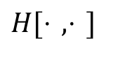
Image filtering
$$H[⋅ ,⋅ ]$$
1
1
1
1
1
1
1
1
1
I$[.,.]$
$$I′[.,.]$$
0 | 0 | 0 | 0 | 0 | 0 | 0 | 0 | 0 | 0
0 | 0 | 0 | 0 | 0 | 0 | 0 | 0 | 0 | 0
0 | 0 | 0 | 90 | 90 | 90 | 90 | 90 | 0 | 0
0 | 0 | 0 | 90 | 90 | 90 | 90 | 90 | 0 | 0
0 | 0 | 0 | 90 | 90 | 90 | 90 | 90 | 0 | 0
0 | 0 | 0 | 90 | 0 | 90 | 90 | 90 | 0 | 0
0 | 0 | 0 | 90 | 90 | 90 | 90 | 90 | 0 | 0
0 | 0 | 0 | 0 | 0 | 0 | 0 | 0 | 0 | 0
0 | 0 | 90 | 0 | 0 | 0 | 0 | 0 | 0 | 0
0 | 0 | 0 | 0 | 0 | 0 | 0 | 0 | 0 | 0
 | 0 | 10 | 20 | 30 | 30 | 30 | 20 | 10
 | 0 | 20 | 40 | 60 | 60 | 60 | 40 | 20
 | 0 | 30 | 60 | 90 | 90 | 90 | 60 | 30
 | 0 | 30 | 50 | 80 | 80 | 90 | 60 | 30
 | 0 | 30 | 50 | 80 | 80 | 90 | 60 | 30
 | 0 | 20 | 30 | 50 | 50 | 60 | 40 | 20
 | 10 | 20 | 30 | 30 | 30 | 30 | 20 | 10
 | 10 | 10 | 10 | 0 | 0 | 0 | 0 | 0
$$I′[m,n]=\sum_{k,l}{H[k,l]} I[m+k,n+l]$$
Credit: S. Seitz

Slide 40

Box Filter - Averaging Filter
What does it do?
Replaces each pixel with an average of its neighborhood
Achieve smoothing effect (remove sharp features)
H$[⋅ ,⋅ ]$
1
1
1
1
1
1
1
1
1
Slide credit: David Lowe (UBC)

Slide 41
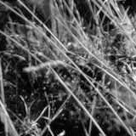
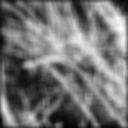
Smoothing with box filter

Slide 42
Filter parameters
Many possible filter parameters (size, weights, function, etc)
Filter size (size of neighborhood): 3x3, 5x5, 7x7, …,21x21,..
Filter shape: not necessarily square. Can be rectangle, circle, etc
Filter weights: May apply unequal weighting to different pixels
Filters function: can be linear (a weighted summation) or nonlinear

Slide 43
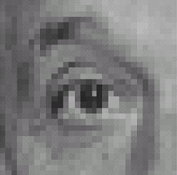
Practice with linear filters
0
0
0
?
0
1
0
0
0
0
Original
Source: D. Lowe

Slide 44
Practice with linear filters
0
0
0
0
1
0
0
0
0
Original
Filtered
(no change)
Source: D. Lowe

Slide 45
Practice with linear filters
0
0
0
?
0
0
1
0
0
0
Original
Source: D. Lowe

Slide 46
Practice with linear filters
0
0
0
0
0
1
0
0
0
Original
Shifted left
By 1 pixel
Source: D. Lowe

Slide 47
Practice with linear filters
0
0
0
-
1
1
1
?
0
2
0
1
1
1
0
0
0
1
1
1
(Note that filter sums to 1)
Original
Source: D. Lowe

Slide 48
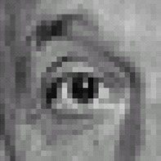
Practice with linear filters
0
0
0
-
1
1
1
0
2
0
1
1
1
0
0
0
1
1
1
Original
Sharpening filter
Accentuates differences with local average
Source: D. Lowe

Slide 49
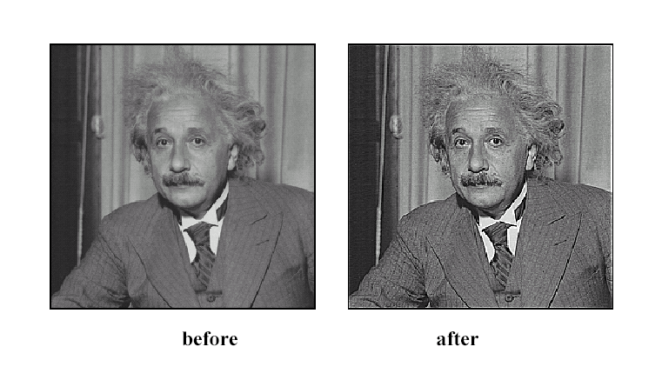
Sharpening
Source: D. Lowe

Slide 50
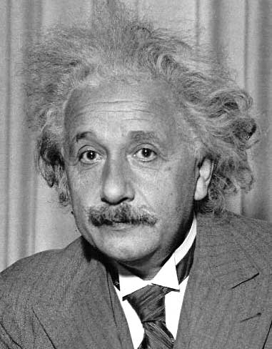
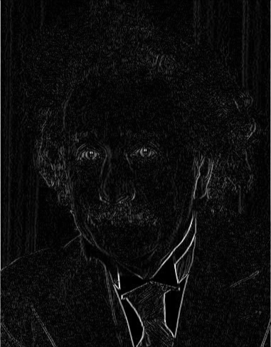
Other filters
1
0
-1
2
0
-2
1
0
-1
Sobel
Vertical Edge
(absolute value)

Slide 51
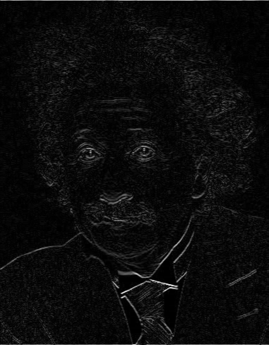
Other filters
1
2
1
0
0
0
-1
-2
-1
Sobel
Horizontal Edge
(absolute value)

Slide 52
Basic gradient filters
Horizontal Gradient
Vertical Gradient
0
0
0
0
1
0
-1
0
1
-1
0
1
0
0
0
or
0
0
0
0
-1
0
or
-1
0
1

Slide 53
Effect of filter size

Slide 54
2D Convolution (Image Filtering)
Applying linear filters: Convolution
Filter matrix (H) moves over each pixel in original image (I) to compute corresponding pixel in new image (I’)
Images can be filtered with various low-pass filters(LPF), high-pass filters(HPF) etc.
LPF helps in removing noises, blurring the images etc.
HPF filters helps in finding edges in the images
OpenCV provides a function cv2.filter2D() to convolve a kernel with an image
dst = cv2.filter2D(img,-1,kernel)

Slide 55
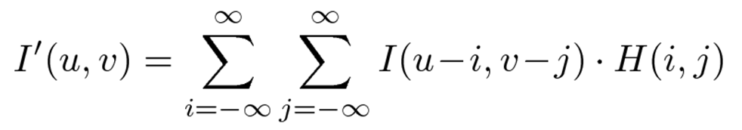
2D Convolution (Image Filtering)
Applying a filter as described called linear convolution
For discrete 2D signal, convolution defined as:

Slide 56
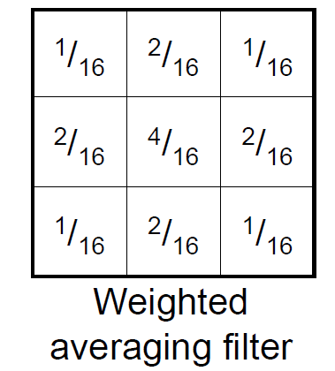
Weighted smoothing filters
More effective smoothing filters can be generated by allowing different pixels in the neighborhood different weights in the averaging function
Pixels closer to central pixel more important
Often referred to as a weighted averaging

Slide 57
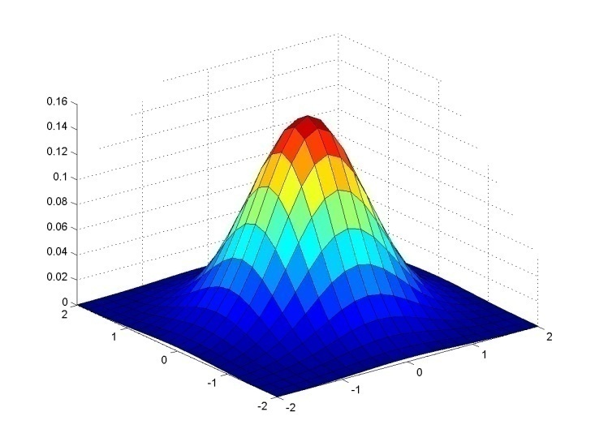
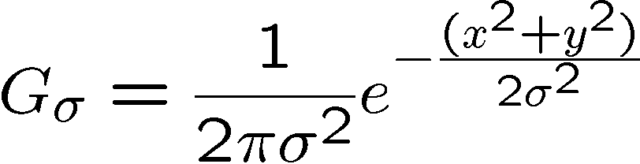
Important filter: Gaussian
Spatially-weighted average
0.003 0.013 0.022 0.013 0.003
0.013 0.059 0.097 0.059 0.013
0.022 0.097 0.159 0.097 0.022
0.013 0.059 0.097 0.059 0.013
0.003 0.013 0.022 0.013 0.003
5 x 5, σ = 1
More weight applied to center
Slide credit: Christopher Rasmussen

Slide 58
Gaussian filters
Remove “high-frequency” components from the image (low-pass filter)
Images become more smooth
Convolution with self is another Gaussian
So can smooth with small-width kernel, repeat, and get same result as larger-width kernel would have
Convolving two times with Gaussian kernel of width σ is same as convolving once with kernel of width σ√2
Separable kernel
2D gaussian is just product of 1D gaussians
Source: K. Grauman
Notes:
Linear vs. quadratic in mask size

Slide 59
Median Filter
Non-linear filter
Much better at removing noise and keeping the structures

Slide 60
Other Non‐Linear Filters
Morphological filters
Corner detection filters

Slide 61
Introduction to Morphological Operators
Collection of non-linear operations related to the shape or morphology of features in an image
Rely only on the relative ordering of pixel values, not on their numerical values, and therefore are especially suited to the processing of binary images (can be extended on grayscale images)
Commonly used in noise removal, object detection, and shape analysis
Morphological operators process images using a structuring element

Slide 62
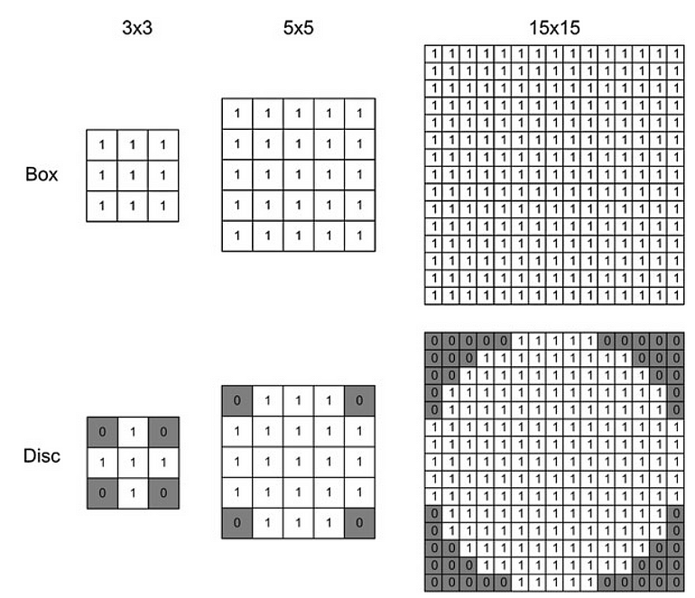
Structuring Element
A small matrix (kernel) used to probe the image
Can be rectangular, circular, or custom-shaped
Defines how the morphological operation interacts with pixels
Usually, element values are 0,1 and none(!)

Slide 63
Types of Morphological Operations
Erosion
Removes pixels on object boundaries
Shrinks objects and eliminates small noise
Useful for removing small white noise from binary images
Dilation
Expands object boundaries by adding pixels
Useful for filling small gaps or connecting broken elements
Strengthens the presence of objects in binary images
Opening - Erosion followed by dilation (removes noise)
Closing - Dilation followed by erosion (fills small holes)

Slide 64
Erosion
Erosion is the set of all points in the image, where the structuring element “fits into”
Consider each foreground pixel in the input image
If the structuring element fits in, write a “1” at the origin of the structuring element
Simple application of pattern matching
Input:
Binary Image (Gray value)
Structuring Element, containing only 1s

Slide 65
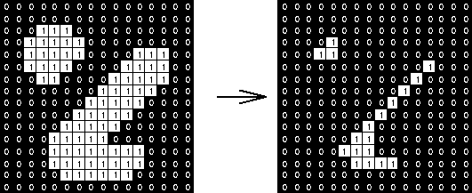
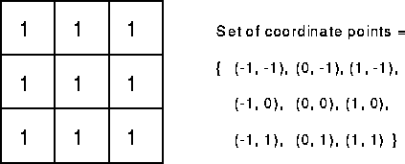
Example Image with erosion
Erosion is an important morphological operation
Applied Structuring Element:

Slide 66
Example for Erosion
Input image
1 | 0 | 0 | 0 | 1 | 1 | 1 | 0 | 1 | 1
Structuring Element
1
1
1
Output Image
 | 0

Slide 67
Example for Erosion
Input image
1 | 0 | 0 | 0 | 1 | 1 | 1 | 0 | 1 | 1
Structuring Element
1
1
1
Output Image
 | 0 | 0

Slide 68
Example for Erosion
Input image
1 | 0 | 0 | 0 | 1 | 1 | 1 | 0 | 1 | 1
Structuring Element
1
1
1
Output Image
 | 0 | 0 | 0

Slide 69
Example for Erosion
Input image
1 | 0 | 0 | 0 | 1 | 1 | 1 | 0 | 1 | 1
Structuring Element
1
1
1
Output Image
 | 0 | 0 | 0 | 0

Slide 70
Example for Erosion
Input image
1 | 0 | 0 | 0 | 1 | 1 | 1 | 0 | 1 | 1
Structuring Element
1
1
1
Output Image
 | 0 | 0 | 0 | 0 | 1

Slide 71
Example for Erosion
Input image
1 | 0 | 0 | 0 | 1 | 1 | 1 | 0 | 1 | 1
Structuring Element
1
1
1
Output Image
 | 0 | 0 | 0 | 0 | 1 | 0

Slide 72
Example for Erosion
Input image
1 | 0 | 0 | 0 | 1 | 1 | 1 | 0 | 1 | 1
Structuring Element
1
1
1
Output Image
 | 0 | 0 | 0 | 0 | 1 | 0 | 0

Slide 73
Example for Erosion
Input image
1 | 0 | 0 | 0 | 1 | 1 | 1 | 0 | 1 | 1
Structuring Element
1
1
1
Output Image
 | 0 | 0 | 0 | 0 | 1 | 0 | 0 | 0

Slide 74


Another example of erosion
White = 0, black = 1, dual property, image as a result of erosion gets darker

Slide 75
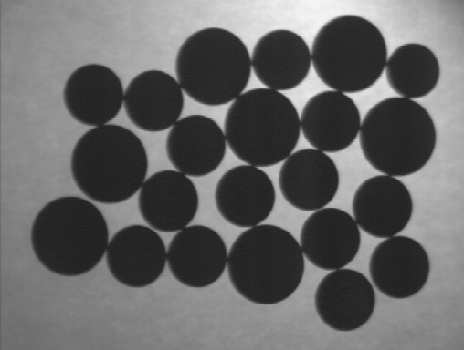
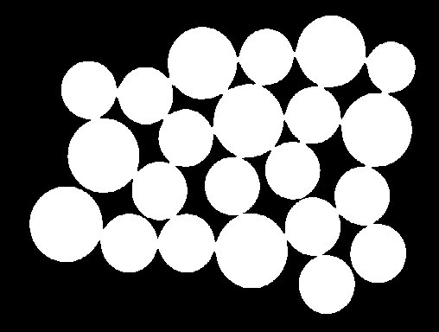

Counting Coins
Counting coins is difficult because they touch each other!
Solution: Binarization and Erosion separates them!

Slide 76
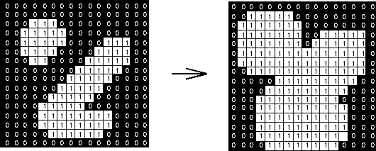
Example Image with Dilation
Dilation is an important morphological operation
Applied Structuring Element:

Slide 77
Dilation
Dilation is the set of all points in the image, where the structuring element “touches” the foreground.
Consider each pixel in the input image
If the structuring element touches the foreground image, write a “1” at the origin of the structuring element!
Input:
Binary Image
Structuring Element, containing only 1s!!

Slide 78
Example for Dilation
Input image
1 | 0 | 0 | 0 | 1 | 1 | 1 | 0 | 1 | 1
Structuring Element
1
1
1
Output Image
 | 1

Slide 79
Example for Dilation
Input image
1 | 0 | 0 | 0 | 1 | 1 | 1 | 0 | 1 | 1
Structuring Element
1
1
1
Output Image
 | 1 | 0

Slide 80
Example for Dilation
Input image
1 | 0 | 0 | 0 | 1 | 1 | 1 | 0 | 1 | 1
Structuring Element
1
1
1
Output Image
 | 1 | 0 | 1

Slide 81
Example for Dilation
Input image
1 | 0 | 0 | 0 | 1 | 1 | 1 | 0 | 1 | 1
Structuring Element
1
1
1
Output Image
 | 1 | 0 | 1 | 1

Slide 82
Example for Dilation
Input image
1 | 0 | 0 | 0 | 1 | 1 | 1 | 0 | 1 | 1
Structuring Element
1
1
1
Output Image
 | 1 | 0 | 1 | 1 | 1

Slide 83
Example for Dilation
Input image
1 | 0 | 0 | 0 | 1 | 1 | 1 | 0 | 1 | 1
Structuring Element
1
1
1
Output Image
 | 1 | 0 | 1 | 1 | 1 | 1

Slide 84
Example for Dilation
Input image
1 | 0 | 0 | 0 | 1 | 1 | 1 | 0 | 1 | 1
Structuring Element
1
1
1
Output Image
 | 1 | 0 | 1 | 1 | 1 | 1 | 1

Slide 85
Example for Dilation
Input image
1 | 0 | 0 | 0 | 1 | 1 | 1 | 0 | 1 | 1
Structuring Element
1
1
1
Output Image
 | 1 | 0 | 1 | 1 | 1 | 1 | 1 | 1

Slide 86

Another Dilation Example
Image get lighter, more uniform intensity

Slide 87
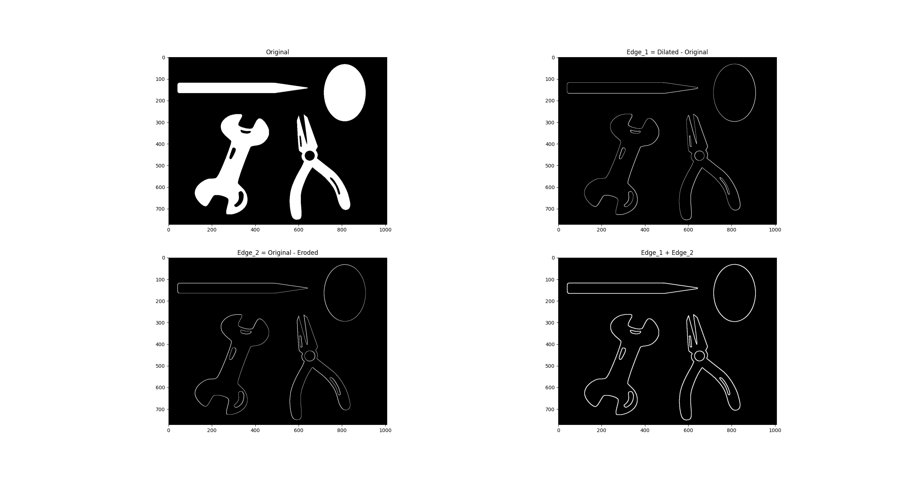
Morphological Gradient
Highlights the edges of objects in an image.
Computed as the difference between dilation and erosion.
Used for edge detection and shape analysis.

Slide 88
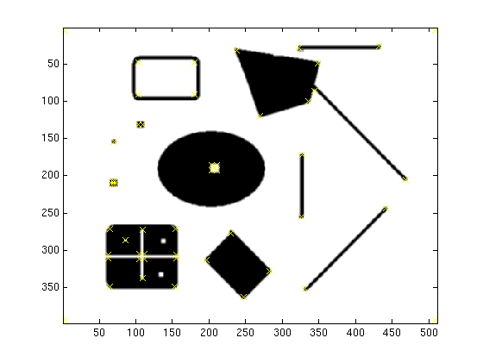
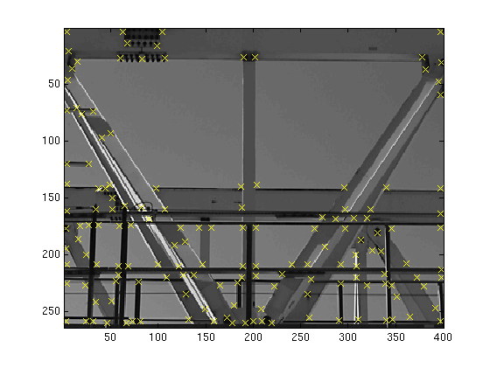

Introduction to Feature Detection
Feature detection identifies important points in an image
These points help in object recognition, image matching, and tracking
Features are distinctive, invariant, and repeatable across different images

Slide 89
Types of Features
Edges - High contrast areas, useful for detecting object boundaries
Corners - Points with large intensity variations in multiple directions
Blobs - Regions of interest where intensity differs from surroundings.

Slide 90
Popular Feature Detection Algorithms
Harris Corner Detector: Identifies corners in an image
SIFT (Scale-Invariant Feature Transform): Detects keypoints at multiple scales.
SURF (Speeded-Up Robust Features): Faster alternative to SIFT
ORB (Oriented FAST and Rotated BRIEF): Efficient, works well for real-time applications

Slide 91
Local Descriptors
Local descriptors represent features as numerical vectors
These vectors help in matching features across images
Common descriptors:
SIFT (128-dimensional descriptor)
SURF (64-dimensional descriptor)
BRIEF (Binary descriptor used in ORB)

Slide 92

Feature Matching
Compares local descriptors to find matching features between images
Brute-Force Matching: Compares all features exhaustively
FLANN (Fast Library for Approximate Nearest Neighbors): Faster approach for large datasets

Slide 93
Applications of Feature Detection
Object recognition (e.g., face detection, product identification)
Image stitching (panoramic image generation)
Augmented reality (aligning virtual objects in real-world scenes)
Motion tracking (e.g., tracking objects in videos)

Slide 94



Project Ideas
Fingerprint matching
https://github.com/robertvazan/fingerprint-datasets
Panorama stitching
https://github.com/visionxiang/Image-Stitching-Dataset
Document scanner

